Slide 1
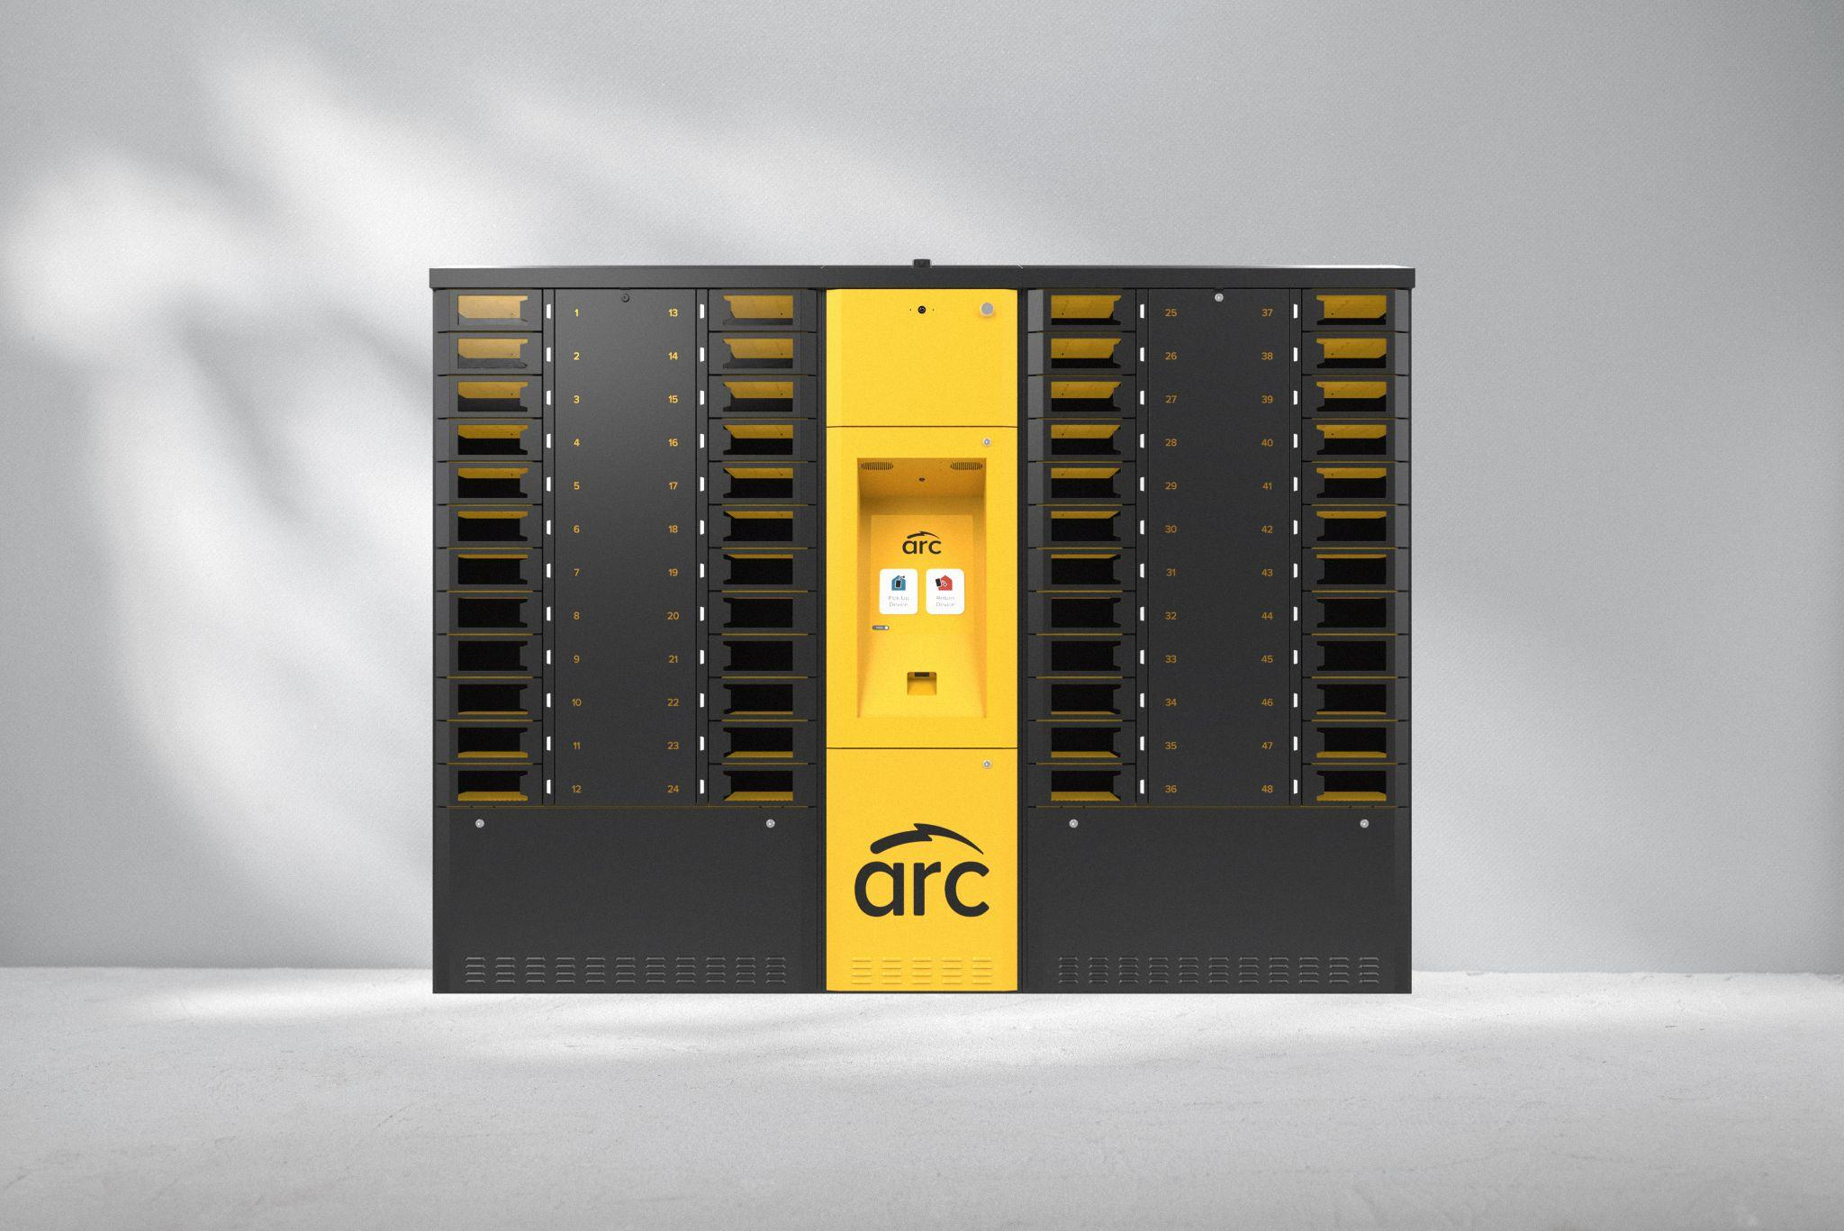
Interpreting the ARC Daily Report

Slide 2
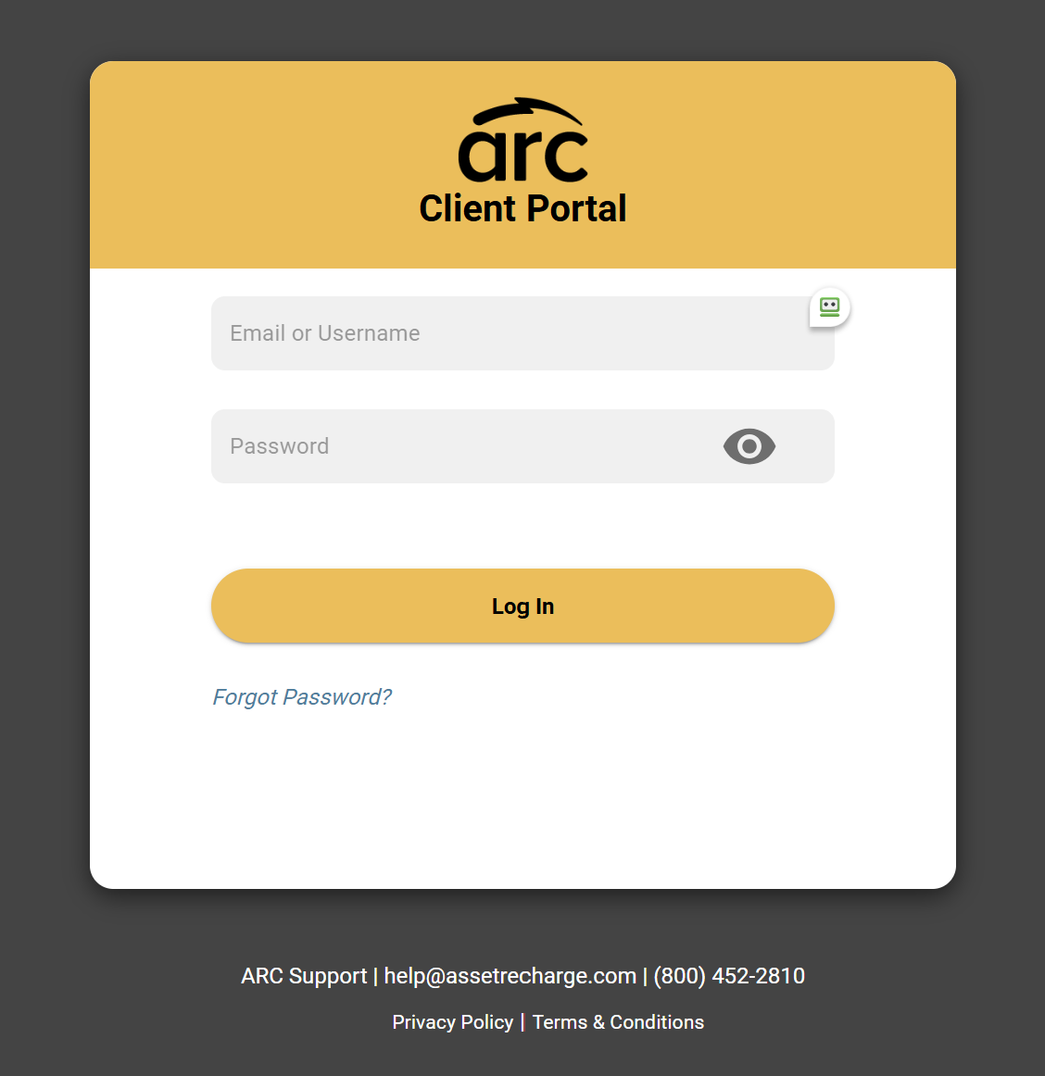
Daily Reporting
ARC Daily Dashboard Reports are Automatically Sent to Leader Email Addresses Daily
Use the report to follow up on:
Overdue Devices
Locker Tasks
Your ARC Score
Devices Removed by Manager
Your Daily Dashboard Report is also available with real-time data by logging into the Client Portal.

Slide 3
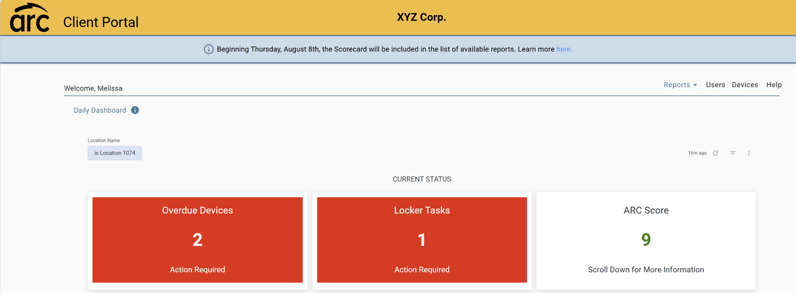
Daily Reporting Overview
You’ll know if you need to follow up on tasks with just one glance; scroll down in the report for additional details on each section.

Slide 4
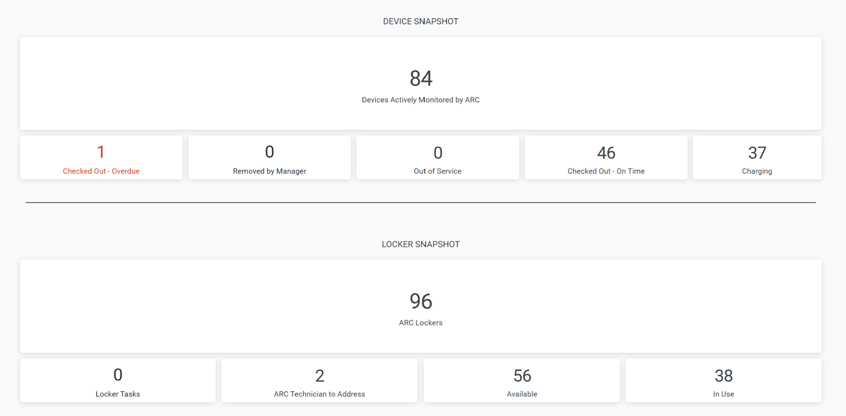
Device & Locker Snapshot
ARC Report Term | Meaning
Devices Actively Monitored by ARC | ALL Devices registered to ARC in Client Portal
Checked Out - Overdue | Total # of Overdue Devices
Removed by Manager | Total # of Devices Removed from Lockers by Managers (should be returned within 72 hours)
Out of Service | Devices Out of Service (removed by manager and needing repair)
Checked Out - On Time | Total # of Devices Currently Checked Out
Charging | Total # of Devices Currently Charging
ARC Lockers | Total # of Lockers on Site
Locker Tasks | # of Manager Locker Tasks to Complete
ARC Technician to Address | # of Lockers Awaiting ARC Technician Visit
Available | Total # of Available (Open) Lockers
In Use | Total # of Lockers Currently in Use
Details on Devices and Lockers

Slide 5
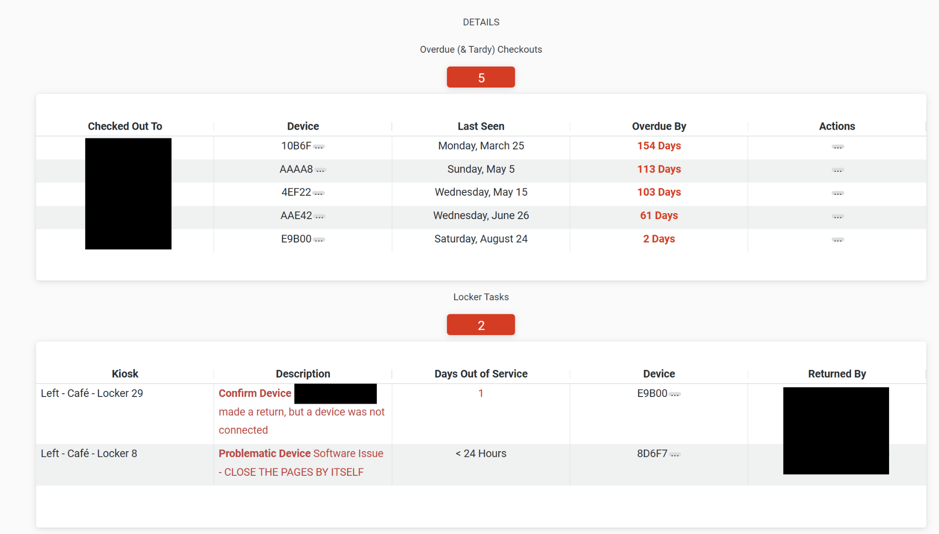
Device & Locker Details
Follow Up on Overdue Devices and Manager Locker Tasks
Use your report to follow up with team members on overdue devices so devices can be returned to ARC kiosks.
Use the report to find details about lockers that are out of service; visit the kiosks to clear red lockers.

Slide 6
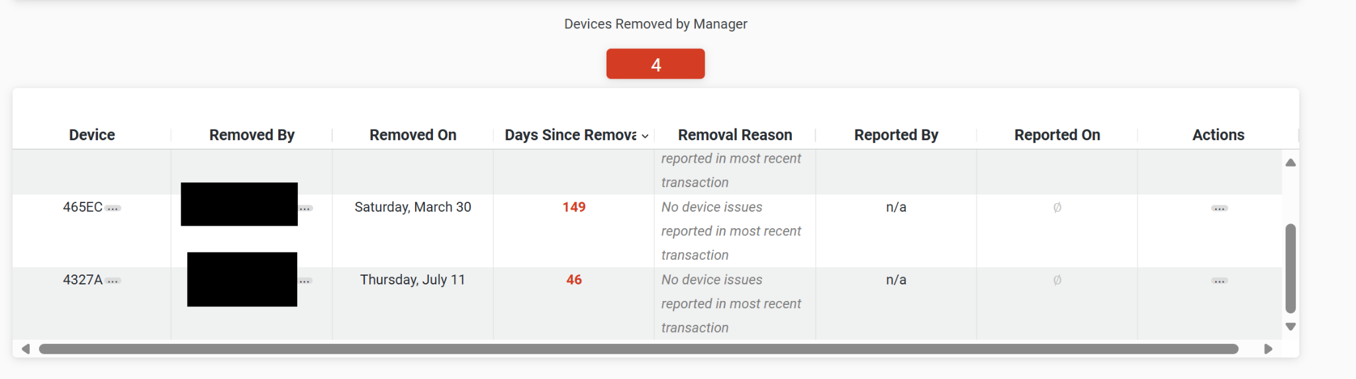
Devices Removed by Manager
Review devices removed by managers for inspection or other reasons. Devices should be returned to ARC within 72 hours. If devices require repair, deactivate the device using RMA status, so ARC is no longer tracking the device.

Slide 7
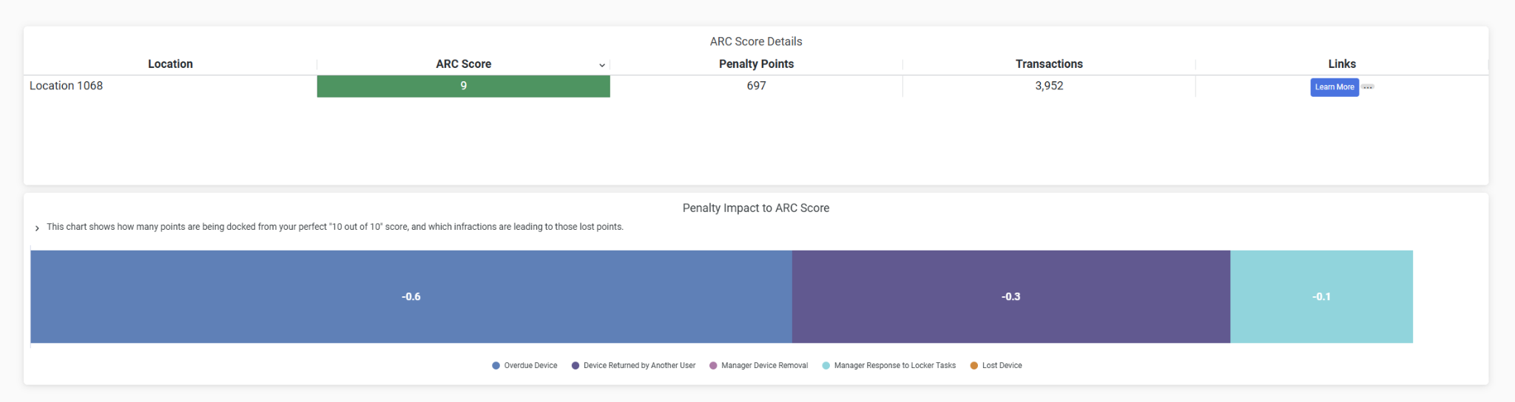
ARC Score (Last 30 Days)
The ARC Score shows you how your location is reporting on a 0-10 scale over a rolling 30 day period. Paying attention and acting upon your daily report and tasks ensures your score stays high! Learn more about your ARC Score at experiencearc.com/training !

